Slide 1
Non-contact Detection of Glucose Concentration: Monte Carlo Simulation
R. Davis, M. Xu

Slide 2
The Invasive Problem
More than 25 million people in the population have diabetes, however, no good solutions currently exist that allow for glucose detection through none invasive means
Using light we can simulate the detection in a substance such as glucose to be able to determine how effect it would be detect the concentration in the body
We want to tackle this problem using the Monte Carlo method to simulate a non-invasive solution.

Slide 3
What is the Monte Carlo Simulation?
It is a way to simulate different scenarios of events, and way in which you control a single variable and vary it, while the rest of the data is randomized.
In our case we explore the EMC – Electric field Monte Carlo - which is one special kind of the simulation

Slide 4

EMC Explained
n
n'
s
m
s'
m'
Notes:
E is the complex electric field with components parallel and perpendicular to the previous scattering plane,
E' is the complex electric field with components parallel and perpendicular to the present scattering plane,
S is the amplitude scattering matrix dependent on the scattering angle θ between the incoming propagation direction and outgoing propagation direction, and
R is the rotation matrix dependent on the angle φ between the incoming perpendicular electric field component and the outgoing perpendicular electric field component.
The rotation matrix R rotates the reference frame φ degrees azimuthally to align the incoming perpendicular electric field component to the normal of the present scattering plane

Slide 5
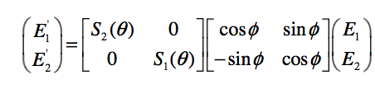

S Matrix
$E_{1}$ and $E_{2}$ are the complex parallel and perpendicular components of the incoming
electric field and $E_{1}′$ and $E_{2}′$ are the complex electric field components after the scattering event.
Notes:
The properties of the scattering particle are contained in the S matrix: S1 and S2 dependent on the refractive indices inside and outside the particle as well as the size of the
particle and the wavelength of the incident light.

Slide 6
What is the CBS Phenomena
CBS – or Coherent Backscattering Enhancement
Weak localization of light can be detected since it is manifested as an enhancement of light intensity in the backscattering direction

Slide 7
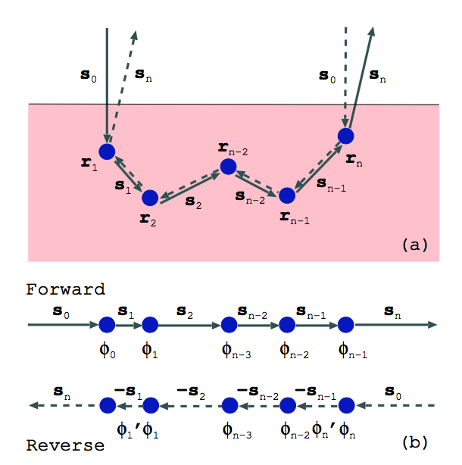

Slide 8
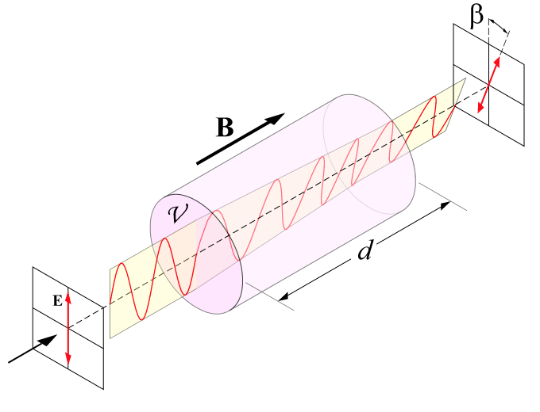

Incorporating Faraday Rotation by Glucose
The foundation for the detection:
$$θ= θB∙L$$

Slide 9
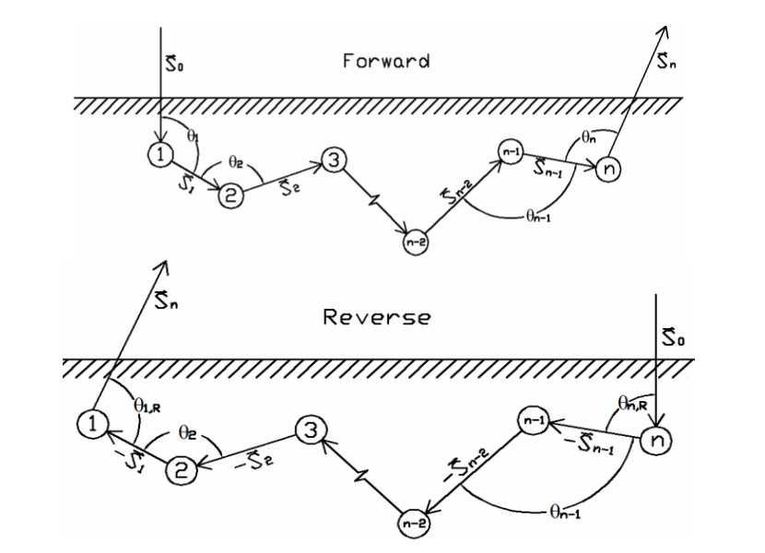
forward and Reverse - path
This is an example of the path being in the forward and reverse direction if the initial entry point is straight

Slide 10
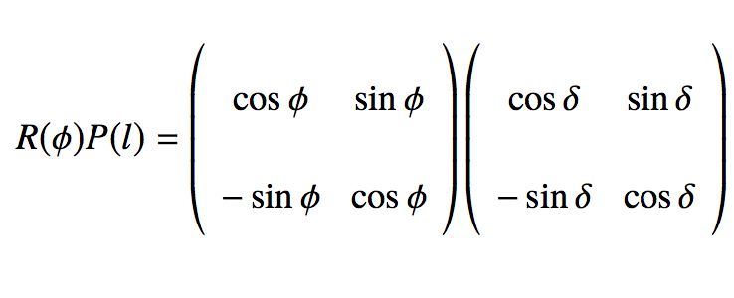
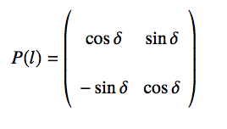



Varying the angle of rotation Due to Faraday
We accommodate for the Faraday rotation by adding a P factor to the already existing rotation
$$R\left(φ\right)=\left(\begin{matrix}\cos{φ} & \sin{φ} \\ −\sin{φ} & \cos{φ}\end{matrix}\right)$$
$δ=\frac{1}{2}(θ_{x}B_{x}δx+θ_{y}B_{y}δy+θ_{z}B_{z}δz)$

Slide 11
Before the Introduction of the Faraday Effect
After the Introduction of the Faraday Effect
Before the Introduction of the Faraday Effect
After the Introduction of the Faraday Effect

Slide 12
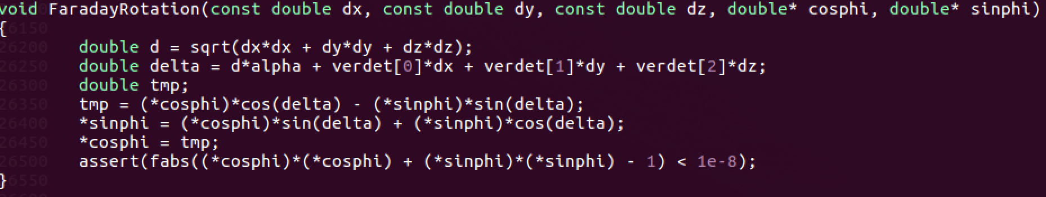

Slide 13
What the current code does:
The code launches a photon in both the forward and the backwards direction
The code then calls a move function that moves the photon from entry to into the medium and collides it with the first molecule
Then the scatter event is called which scatters that photon in the medium
Upon scattering the photon experiences a rotation

Slide 14

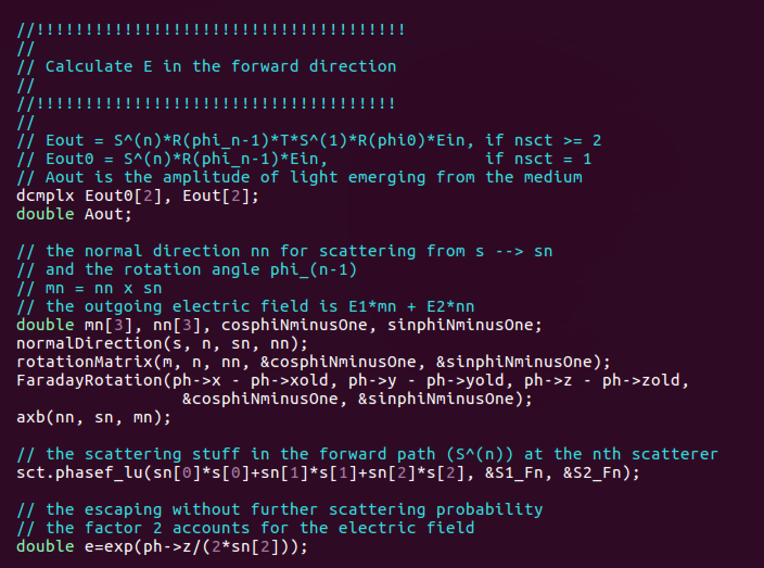

Slide 15
Faraday Rotation vs. Enhancement Factor

Slide 16
What Have I learned so Far:
How to express matrix calculations in code
The behavior of polarized light due to CBS
How the magnetic field influences the Faraday rotation

Slide 17
Next Step
Present data with different B, as well vary circular versus linear polarization
Vary in which direction Verdet constant is applied: x, y, z
Prepare for the report
Time permitting carry out the experiment

